Slide 1
Boy Giant: Son of Gulliver

Slide 2
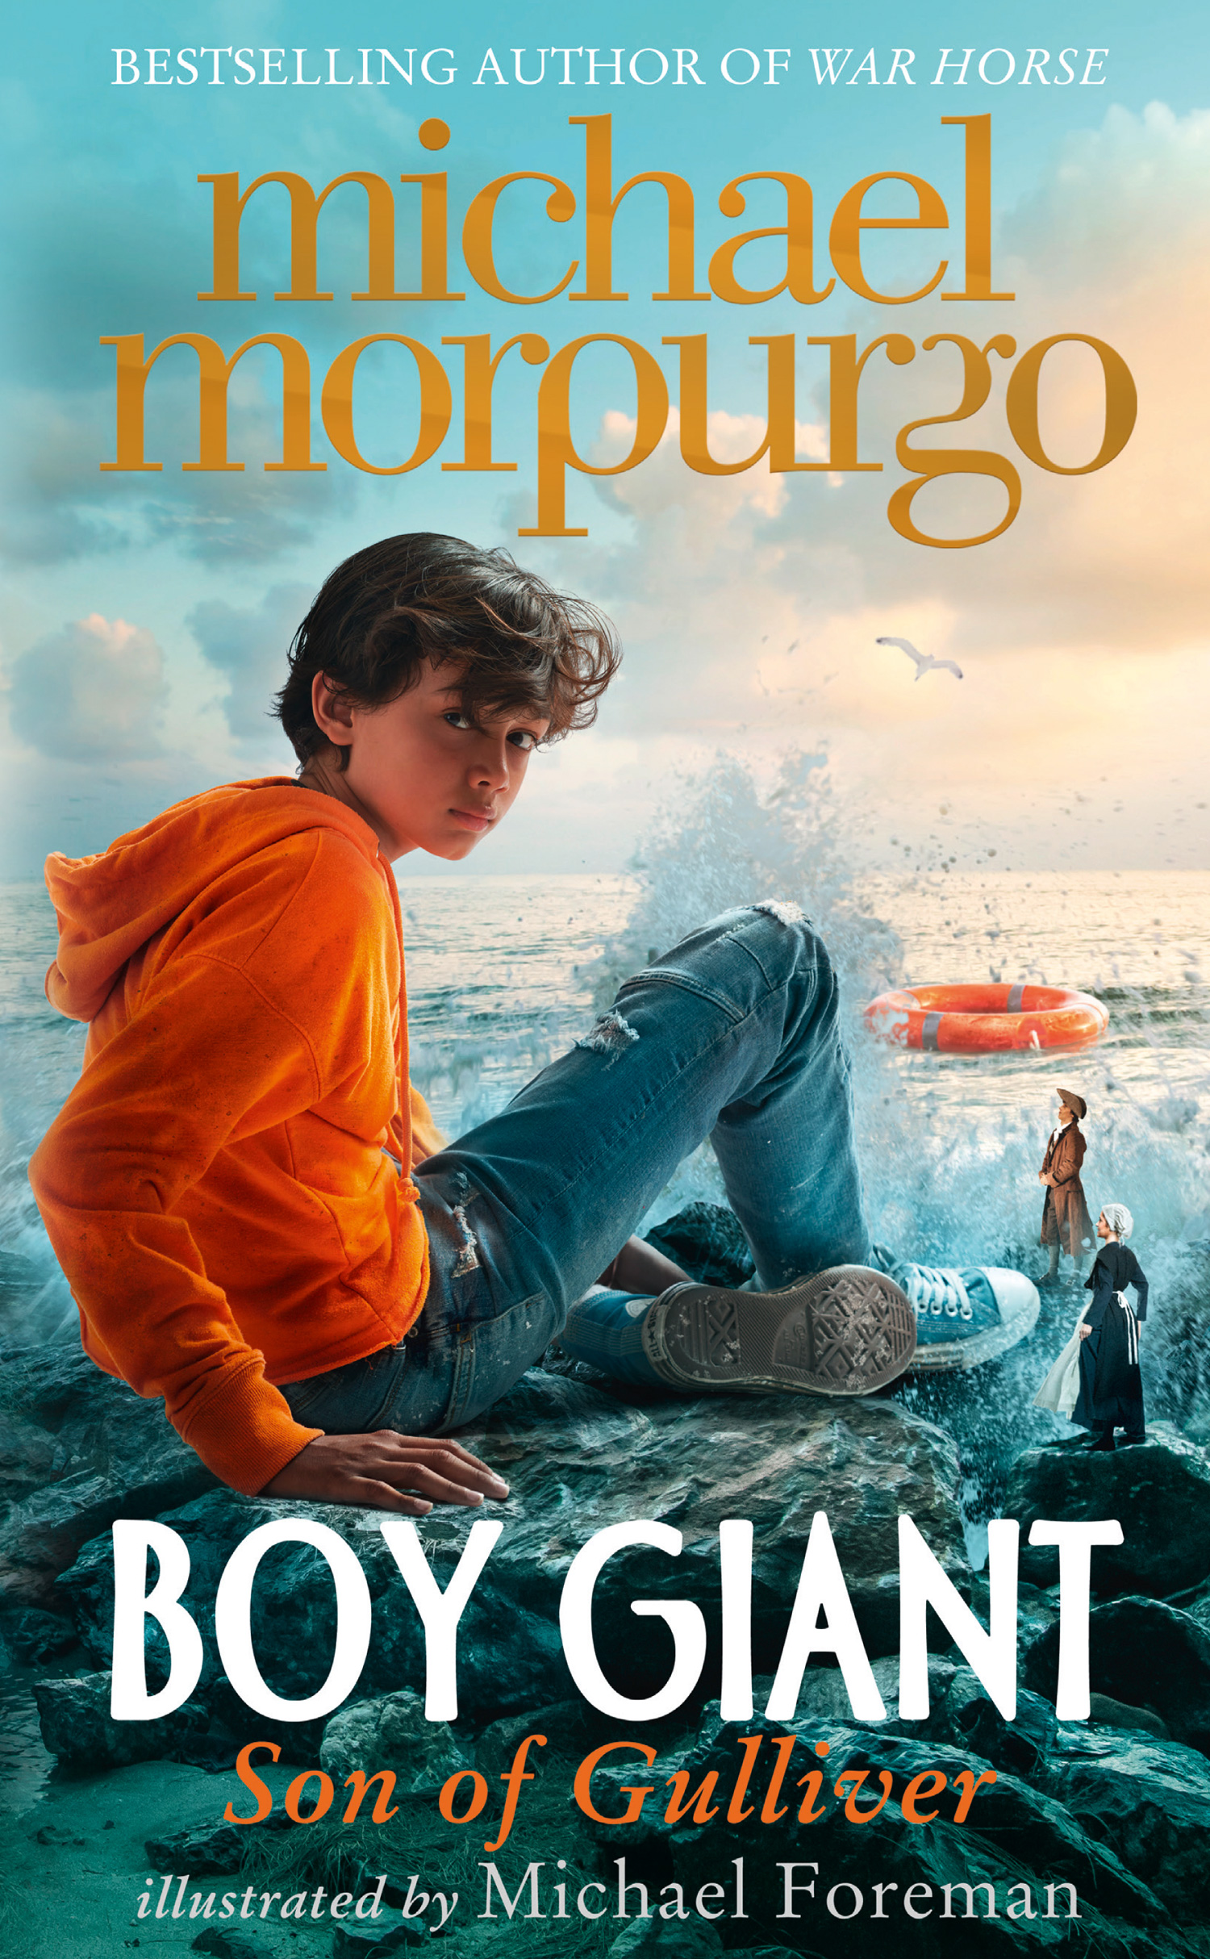
Boy Giant: Son of Gulliver
A little hope makes a big difference.
War has forced Omar and his mother to leave their home in Afghanistan and venture across the sea to Europe. When their boat sinks, and Omar finds himself alone, with no hope of rescue, it seems as if his story has come to an end.
But it is only just beginning…

Slide 3
Discussion questions
The characters in Boy Giant make many different journeys. Which journey do you think is the most important in the story? Why?
Why did the emperor of Lilliput release Gulliver from his chains? Was it out of kindness? Why/why not?
Why do the people of Mevagissey think Omar talks in ‘an old-fashioned way’?
Which place in the story makes Omar happiest? Explain your answer.
Does the story end happily for all of the characters? Do Omar, J.J., Zaya and Natoban all get the ending they deserve? Why/why not?

Slide 4
Class debate
Omar was right to break the Blufescuan’s property because it led to peace between the two islands
Do you agree or disagree with this statement?
Why/why not?

Slide 5
Casting the ships out to sea
With the other hand I reached down and grabbed handfuls of anchor chains from the decks of the warships, and began to haul as many of them as I could out of the harbour. Everywhere sailors were abandoning their warships, leaping overboard in their hundreds.
Once out in the open sea, I let the warships go, and left them to drift away. Then I waded back into the harbour on Blufescu to fetch some more of them. I made the journey several times in and out of the harbour, each time under a shower of arrows, and there were musket balls and cannonballs bouncing off me too. Some of those did hurt, but not enough to trouble me much. And all the time the Blufescuans were shaking their fists at me, yelling at me, cursing me.
All along the shores of Lilliput the people were cheering and waving. I could hear a distant chanting, echoing over the ocean: “Owzat! Owzat! Owzat!”

Slide 6
Emperor Bronar’s palace
The people there were hiding where they could, looking up at me terrified. All of them were thin, and pale and dirty, their clothes in tatters. And there in the middle of the island surrounded by a great moat was the emperor’s palace. I knew what to do with that.
I set about pulling the palace down, wall by wall, room by room, and then I trampled on it. This took me a while, and as I was finishing I heard behind me a giant cheer. I saw the enslaved people of Blufescu charging towards the great stone wall surrounding the island. They had ladders, they had hammers, and they were angry. Soon they were knocking it down with anything they could find. Some were sitting up there astride the wall and pulling away the stones with their bare hands. I went to help them. Between us we flattened that great wall to the ground in a few hours, leaving in its place nothing but scattered stones, strewn everywhere. Nothing was left standing.

Slide 7
Features of a newspaper article
A headline that captures the reader’s attention
A lead paragraph which outlines the who, what, where, why and how of the event
A second paragraph that goes into further detail, featuring supporting facts, interviews or quotes and a commentary or opinion on events
A conclusion drawing the piece to a close and speculating about what might happen next

